Slide 1
System Simulation of Networked Autonomous Units Tracking and Intercepting Intruders
ME EN 595R Final Project
Carsten Christensen and Landon Willey

Slide 2
Problem Development

Slide 3
Problem Summary
Objective: Model a system wherein a group of networked autonomous defenders must, using only one UAV, detect, track, and intercept multiple intruding attackers.
Approach: Use a series of modified-EKFs to estimate the locations for each of the mobile defending units and Monte-Carlo localization to estimate the projected movement of the intruders.
Challenges: Everything is moving, including all but one of the landmarks.
The unknown nature of the intruders’ paths.
Importance: Autonomous warfare is the future

Slide 4
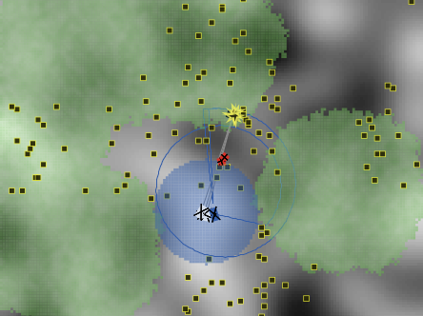
Background and Motivation
Pursuit/Evasion Games
Battlefield Simulations
Attackers or evaders attempt to cross a border guarded by a faster defender or pursuer
Defending allied units protect their zone of control from invading enemy units

Slide 5
The Teams
Defenders
Attackers
Objective: Detect and prevent any intruders from traversing their controlled zone and reaching their base.
Agents:
2 autonomous robot ground interceptors
1 autonomous UAV patroller
Objective: Traverse the defenders controlled zone and reach their base before being intercepted
Agents:
2 ground intruders

Slide 6
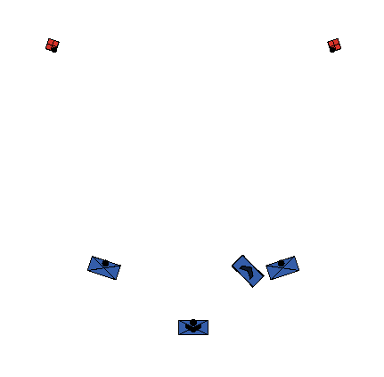
Agent Overview
Defenders: Base/Control Unit
Purpose: Landmark for UAV and
objective for intruders
Defenders: Ground Interceptor
Purpose: Landmark for UAV and
intercept intruders
Defenders: Patrol UAV
Purpose: Detect intruders and
direct interceptors
Attackers: Ground Intruder
Purpose: Target for defending UAV and interceptors

Slide 7
Modeling Approach

Slide 8
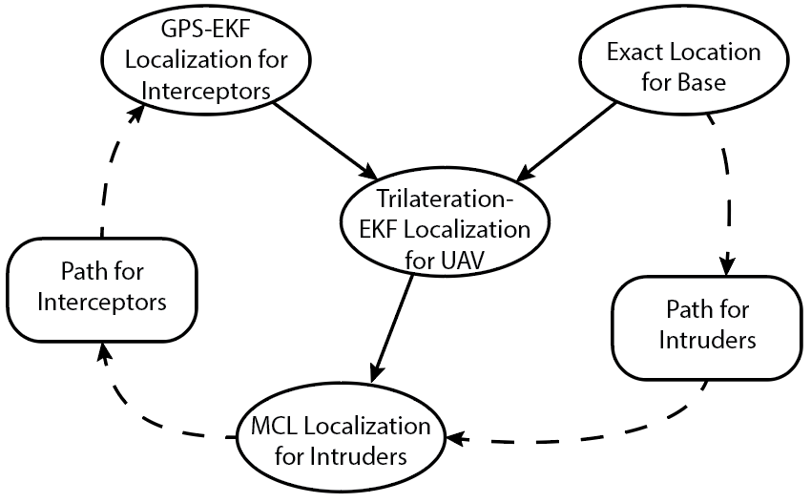
System Overview

Slide 9
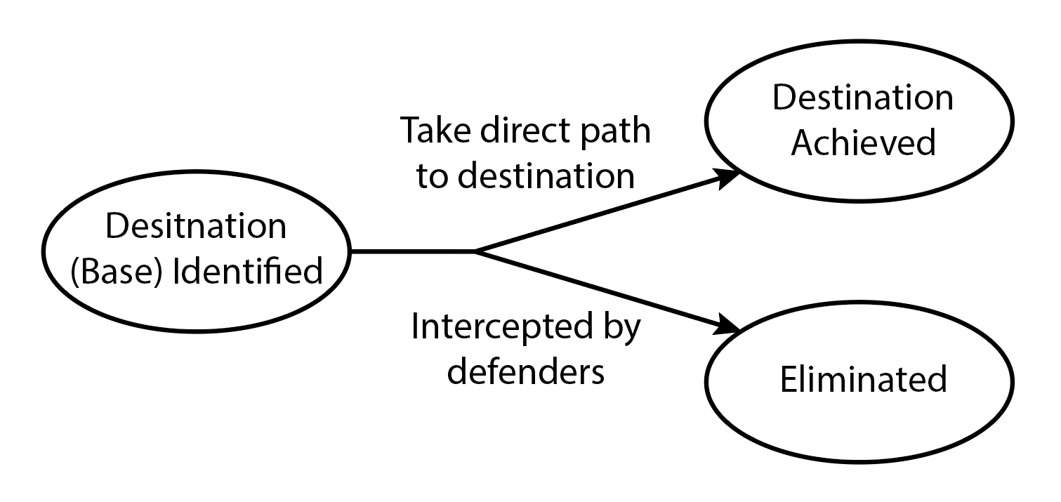
Intruder Subsystem
Zero-Acceleration Linear Dynamics
Assumptions:
Defenders do not know intruders’ path planning or movement model – intruders are only observable
Model:
Moves from start position to defender base in a direct line
Simple zero-acceleration model with motion noise

Slide 10
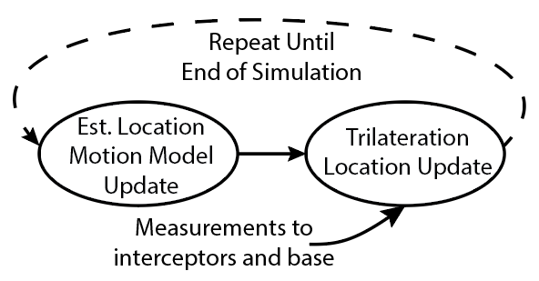
UAV Subsystem – Localization
Assumptions:
UAV has reliable network communications with base and interceptors
Base location is known exactly and fixed
Model:
2D fixed-wing flight motion model with turning constraint
UAV follows a fixed search path until both intruders have been found, then tracks the one with greater uncertainty
Error propagates from moving landmarks into UAV position estimate
EKF with Trilateration Measurement Update

Slide 11
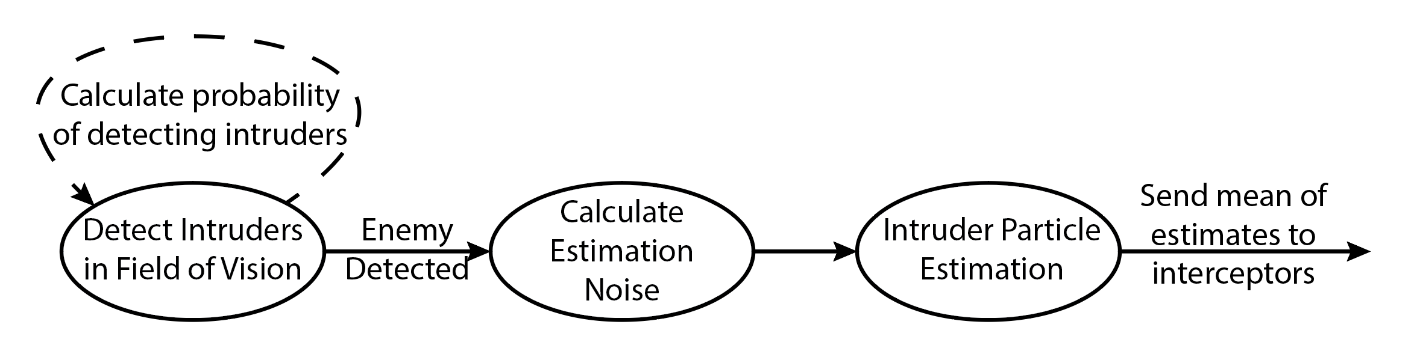
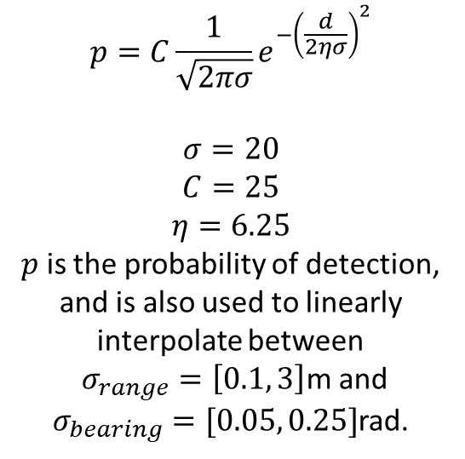
UAV Subsystem – Intruder Localization
$$p=C\frac{1}{\sqrt{2πσ}}e^{−{\left(\frac{d}{2ησ}\right)}^{2}}$$
$$σ=20$$
$$C=25$$
$$η=6.25$$
$p$ is the probability of detection, and is also used to linearly interpolate between
$σ_{range}=\left[0.1, 3\right]$m and $σ_{bearing}=[0.05, 0.25]$rad.
Assumptions:
Constant velocity for intruders
Equations for detection probability
Camera-like range and bearing sensor
Model:
500 particles; X, Y, θ states
Heading noise for samples dependent on calculated weight
Monte-Carlo Localization of Visible Waypoints

Slide 12
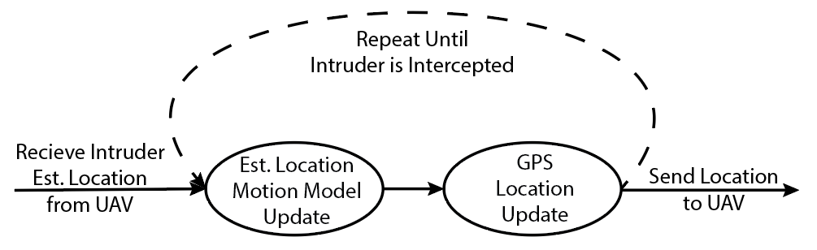
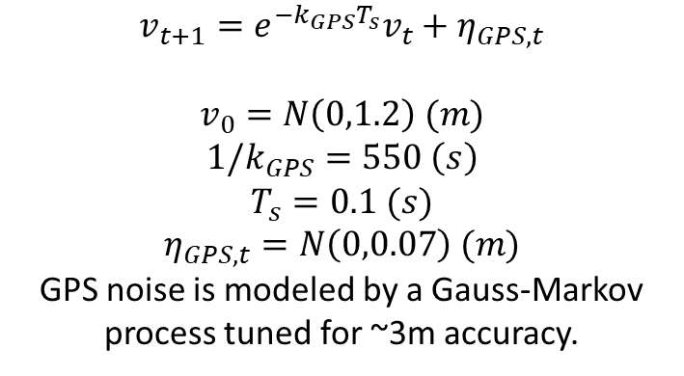
UAV Subsystem – Interceptor Localization
Assumptions:
Interceptor has reliable GPS; ±3 m error
Model:
Unicycle motion model
Measurement update based solely on GPS
$$v_{t+1}=e^{−k_{GPS}T_{s}}v_{t}+η_{GPS,t}$$
$$v_{0}=N\left(0,1.2\right) (m)$$
$${1/k}_{GPS}=550 \left(s\right)$$
$$T_{s}=0.1 (s)$$
$$η_{GPS,t}=N\left(0,0.07\right) (m)$$
GPS noise is modeled by a Gauss-Markov process tuned for ~3m accuracy.
EKF with GPS Measurement Update

Slide 13
UAV Subsystem – Interceptor Localization
EKF with GPS Measurement Update
GPS noise over time

Slide 14
Modeling Results

Slide 15
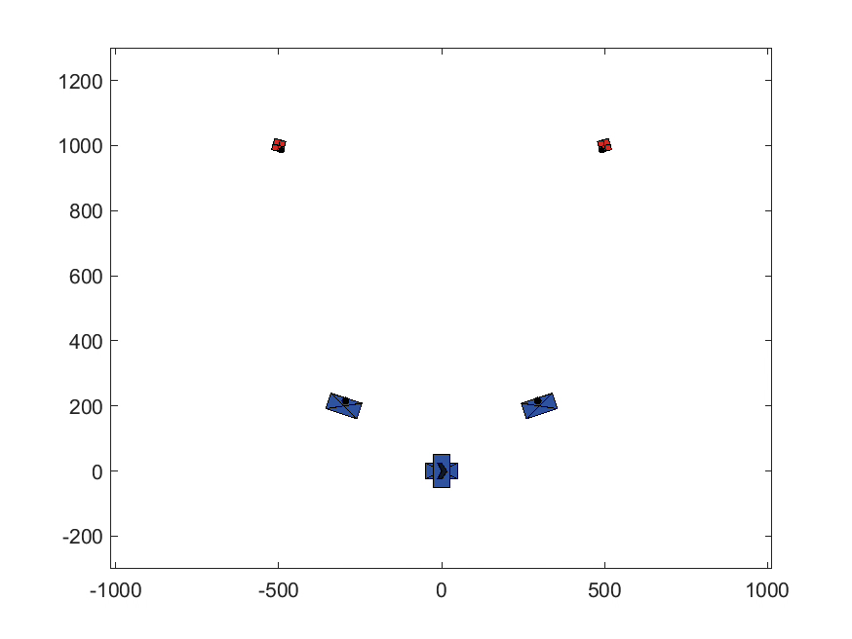
Key Accomplishment – Scenario Simulation

Slide 16
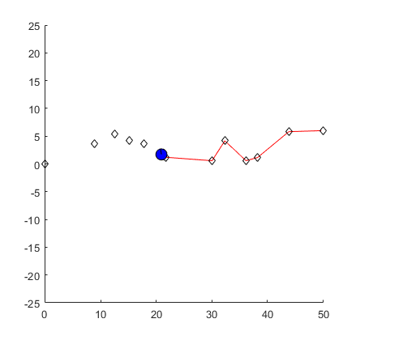
Attempted Methods
Intruder Motion Model
Intruders initially followed a speed-varying path between randomly distributed waypoints
Final Method: constant velocity, straight path
Estimation Methods
Treating attackers as a stationary landmark
Works well with long-range sensors
Numerical differentiation to estimate speed
Less sensor and motion noise might make it possible
EKF with position and velocity state
MCL with position and velocity state
Final Method: MCL with assumed constant velocity

Slide 17
Primary Takeaways
Lessons Learned
Moving landmarks do not introduce significant trilateration error unless closely grouped
Determining the velocity of a moving target based solely on position data is very difficult
Filters do not work as well when estimating states that are not directly measured
MCL using assumed intruder velocity model worked well within ±5%

Slide 18
Works Cited
Beard, R. W., & McLain, T. W. (2012). Small Unmanned Aircraft: Theory and Practice. Pp 139. Princeton University Press.
Other self-authored works at varying stages in the publication process

